Slide 1


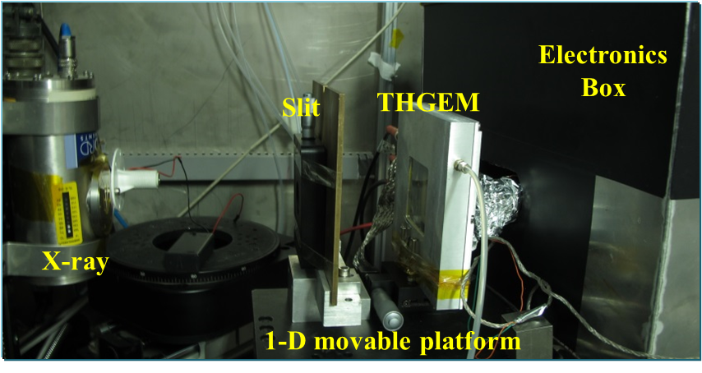
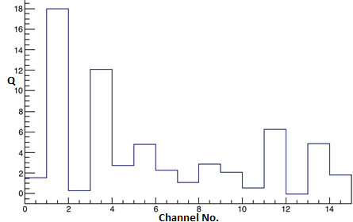
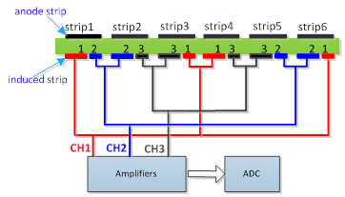
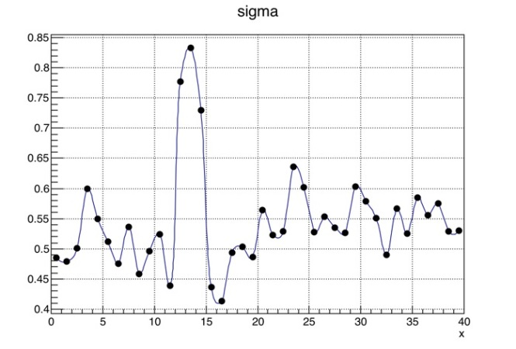
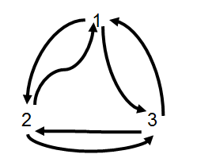
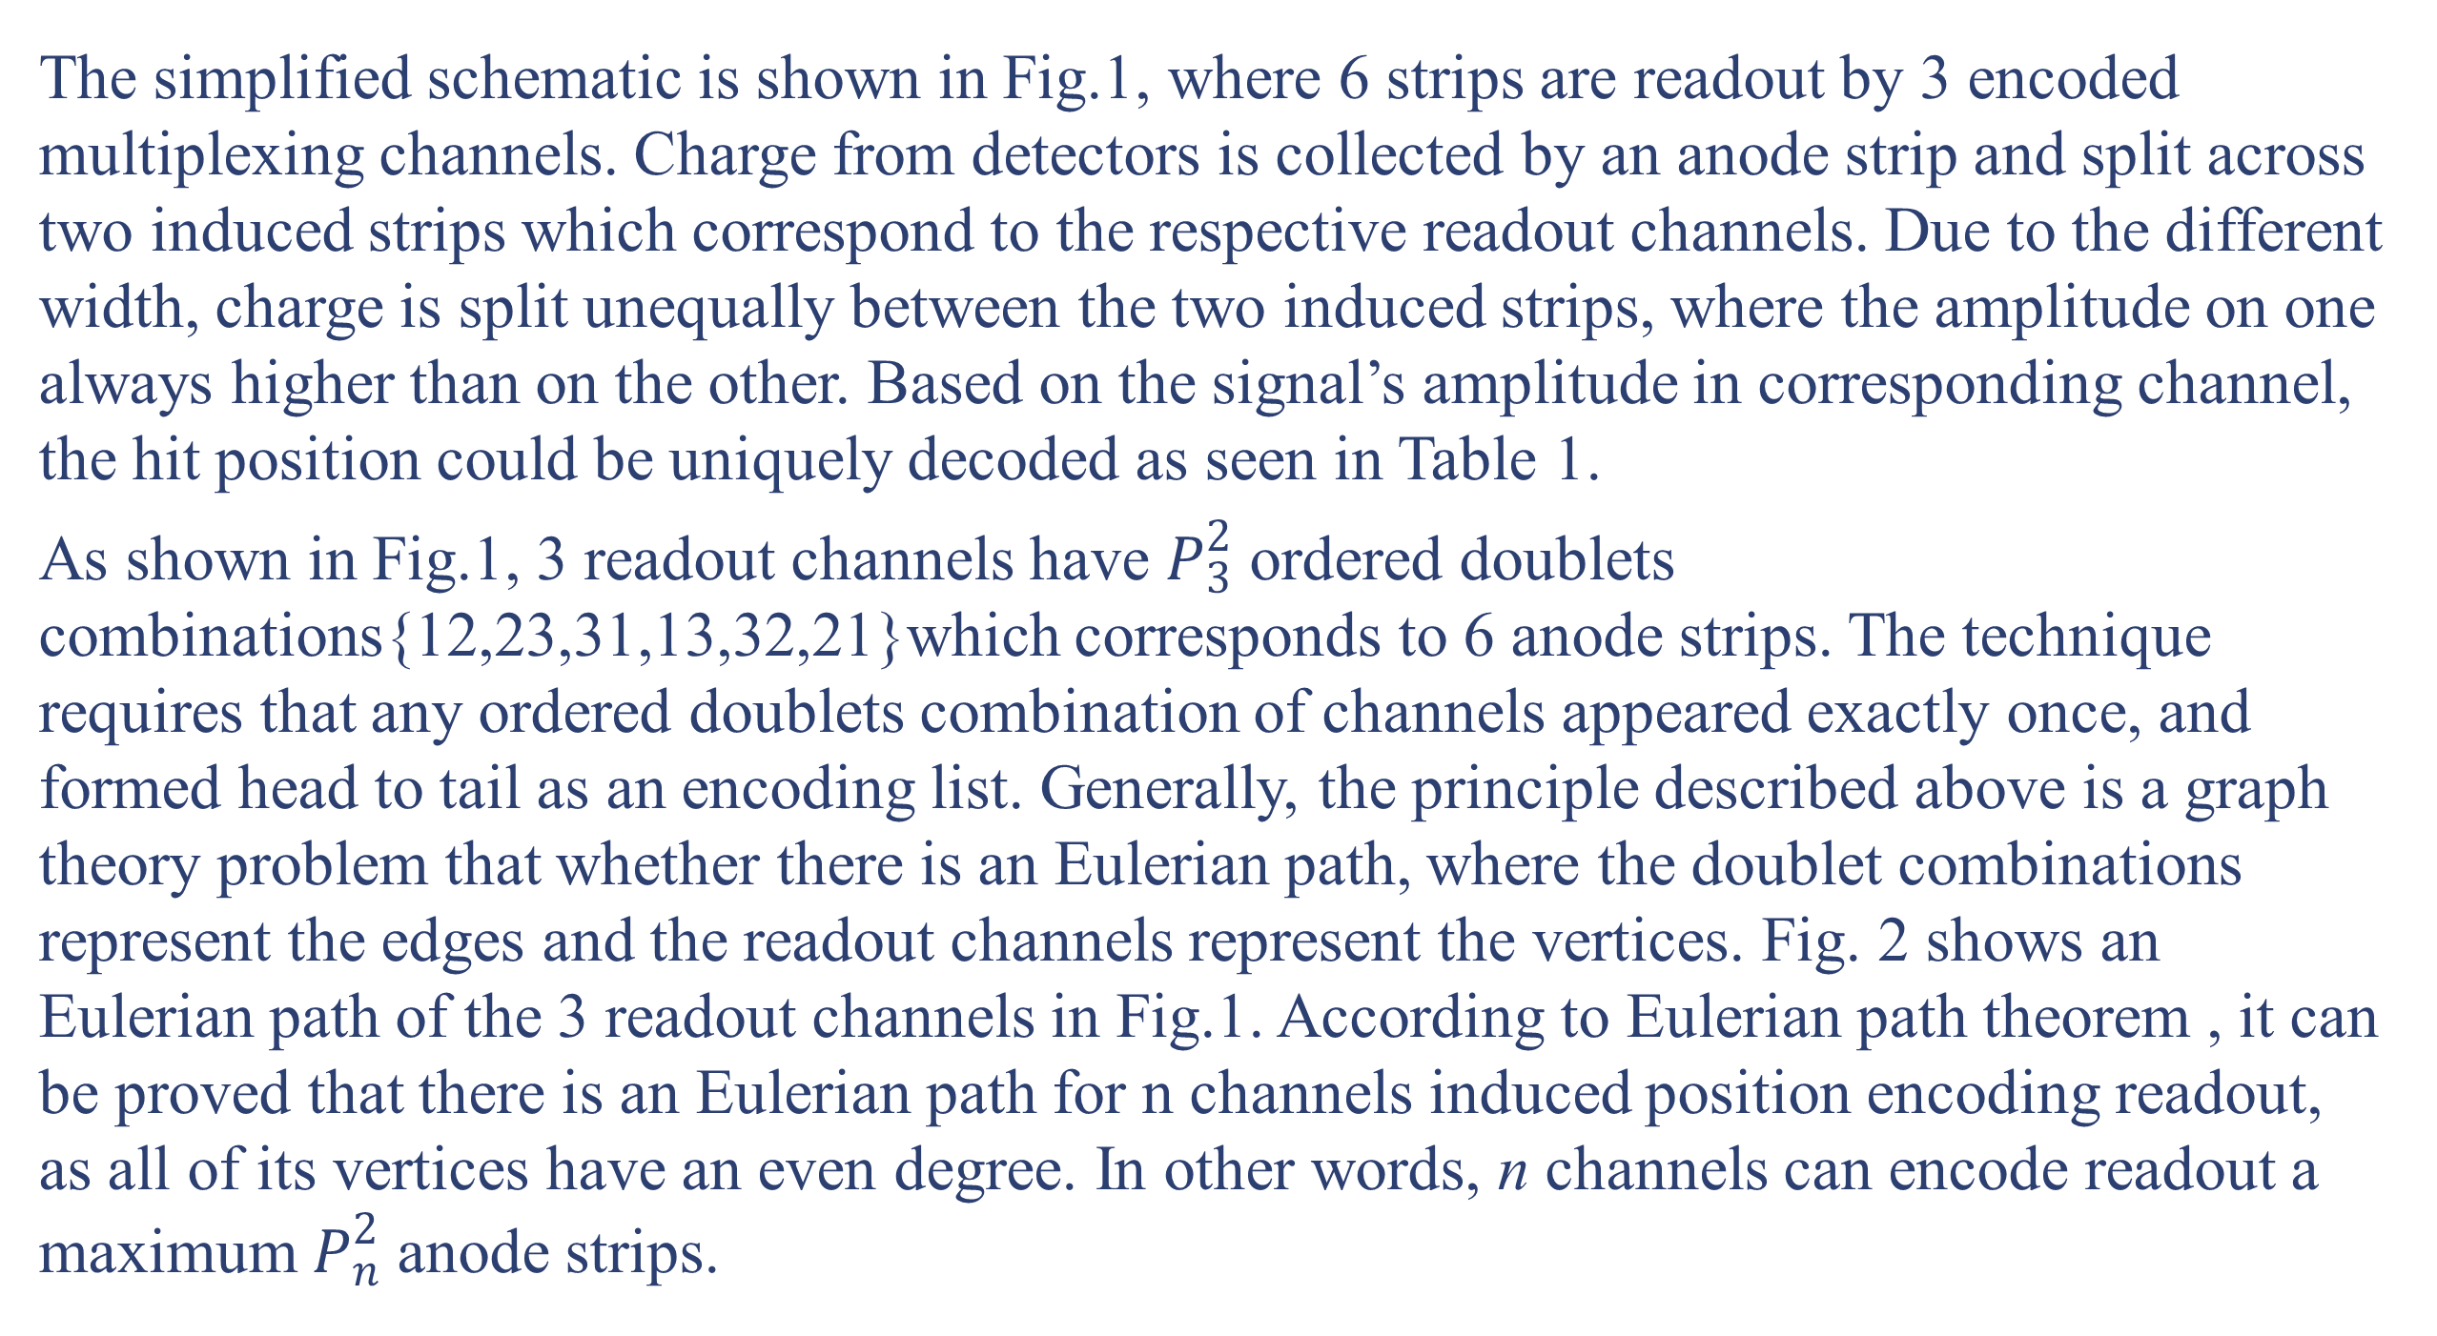
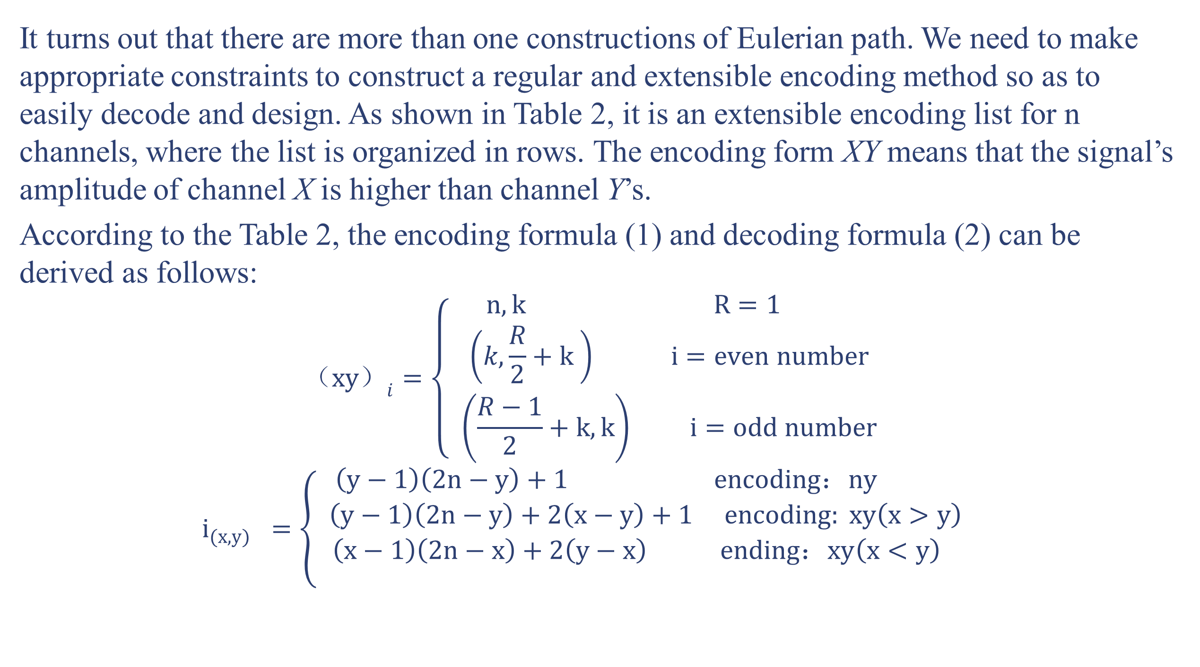
An Extensible Induced Position Encoding Readout Method for Micro-pattern Gas Detectors
Shubin Liu, Binxiang Qi, Siyuan Ma, Zhongtao Shen, Guangyuan Yuan,
Qi An
State Key Laboratory of Particle Detection and Electronics, University of Science and Technology of China, Hefei City, Anhui Province, China
Siyuan Ma
1. Introduction
It turns out that there are more than one constructions of Eulerian path. We need to make appropriate constraints to construct a regular and extensible encoding method so as to easily decode and design. As shown in Table 2, it is an extensible encoding list for n channels, where the list is organized in rows. The encoding form XY means that the signal’s amplitude of channel X is higher than channel Y’s.
According to the Table 2, the encoding formula (1) and decoding formula (2) can be derived as follows:
$${（xy）}_{i}=\left\{ \begin{aligned} n,k R=1 \\ \left(k,\frac{R}{2}+k \right) i=even number \\ \left(\frac{R−1}{2}+k,k\right) i=odd number \end{aligned}\right.$$
$$i_{(x,y)} =\left\{ \begin{aligned}\left(y−1\right)\left(2n−y\right)+1 encoding：ny \\ \left(y−1\right)\left(2n−y\right)+2\left(x−y\right)+1 encoding: xy\left(x>y\right) \\ \left(x−1\right)\left(2n−x\right)+2\left(y−x\right) ending：xy\left(x<y\right) \\ \end{aligned}\right.$$
Over the past 20 years, Micro-pattern Gas Detectors (MPGDs) are widely used in high-energy physics, and have expanded to astrophysics, nuclear physics and medical imaging. The conventional readout techniques employ a large number of electronic channels, which poses a big challenge to the further applications of MPGDs. By changing the readout electrode’s structure and multiplexing the readout channels, an induced position encoding technique for micro-channel plate detector was developed by D. Kataria et al. in 2007. The technique was used for MPGDs by R. Hu et al. in 2011, where a preliminary feasibility test was implemented with Micromegas. This technique can significantly reduce the number of readout channels, but the foregoing works didn’t provide an extensible encoding method and the decoding is complicated. In this paper, an extensible induced position encoding readout method for MPGDs is presented. The method is demonstrated by the Eulerian path of graph theory. A standard encoding rule is provided, and a general formula of encoding & decoding for n channels is derived. A prototyping design is implemented on a 5×5 cm² Thick GEM, and verification tests are carried out on a 8 keV Cu X-ray source with 100μm slit.
4. Verification Test
2. Principle and Method
Chanel:comparsion | Strip:position
CH1>CH2 CH2>CH3 CH3>CH1 CH1>CH3 CH3>CH2 CH2>CH1 | Strip 1 Strip 2 Strip 3 Strip 4 Strip 5 Strip 6
Fig. 3. Experimental setup
Fig. 4. The signal recorded on 15 channels when an event hit
Fig. 1. Induced position encoding readout schematic
Table. 1. Decoding table of 3 readout channels
The simplified schematic is shown in Fig.1, where 6 strips are readout by 3 encoded multiplexing channels. Charge from detectors is collected by an anode strip and split across two induced strips which correspond to the respective readout channels. Due to the different width, charge is split unequally between the two induced strips, where the amplitude on one always higher than on the other. Based on the signal’s amplitude in corresponding channel, the hit position could be uniquely decoded as seen in Table 1.
As shown in Fig.1, 3 readout channels have $P_{3}^{2}$ ordered doublets combinations{12,23,31,13,32,21}which corresponds to 6 anode strips. The technique requires that any ordered doublets combination of channels appeared exactly once, and formed head to tail as an encoding list. Generally, the principle described above is a graph theory problem that whether there is an Eulerian path, where the doublet combinations represent the edges and the readout channels represent the vertices. Fig. 2 shows an Eulerian path of the 3 readout channels in Fig.1. According to Eulerian path theorem , it can be proved that there is an Eulerian path for n channels induced position encoding readout, as all of its vertices have an even degree. In other words, n channels can encode readout a maximum $P_{n}^{2}$ anode strips.
Fig. 5. Spatial resolution result of the detector
Fig. 6. Spatial resolution results of position scanning test
In order to verify this method, a prototyping readout board was manufactured and equipped for a 5×5 cm² THGEM detector. To solve the case that each particle usually showers the signal on several neighboring strips, the neighboring strips are separated into three groups to encode respectively. Based on the encoding list shown in Table 2, the prototyping board has 47 one-dimensional 1.07mm strips which readout by 15 channels. According to the decoding formula, the hit strip can be decoded by the fired channels.
As shown in Fig.3, verification tests were carried out on the THGEM detector using a 8 keV Cu X-ray and Ar/iC₄H₁₀ (97:3) gas mixture. A 100 μm slit in a thin brass sheet was used to produce a miniaturized X-ray beam. A manual movable platform was used for the postion scanning test.The electronics is based on the VATA160 chip.
Fig. 4 shows the signals recorded on all 15 channels when an event hit. Considering the noise of electronics is about 7fC, the channel 2 and 4 are valid, and it can correctly to decode the hit position by the encoding form (24). Fig. 5 shows the decoded spatial resolution result of the detector is 0.4 strip (0.43mm). During the position scanning test, the detector was moved with a step size of 0.5 mm in a 20 mm range. Fig. 6 shows the results of spatial resolution in the position scanning test.
3. Encoding and Decoding
Row | Encoding list
1 | 12 | 21
2 | 13 | 32 | 23 | 31
3 | 14 | 42 | 24 | 43 | 34 | 41
.
k-1 | 1k | k2 | 2k | k3 | 3k | k4 | … | k(k-1) | (k-1)k | k1
n-1 | 1n | n2 | 2n | n3 | 3n | n4 |  |  | n(n-1) | (n-1)n | n1
4. Conclusion
Channel: comparsion | Strip: position
CH1>CH2 | Strip 1
CH2>CH3 | Strip 2
CH3>CH1 | Strip 3
CH1>CH3 | Strip 4
CH3>CH2 | Strip 5
CH2>CH1 | Strip 6
A novel method of encoded multiplexing readout for micro-pattern gas detectors is presented in this work. The method is demonstrated by the Eulerian path of graph theory. A standard rules for encoding is provided, and general formulas of encoding & decoding for n channels are derived. Under the premise of such rules, a one-dimensional position encoding readout circuit boards is designed based on a 5×5 cm² THGEM，and a verification test is carried out on a 8 keV Cu X-ray source with 100μm slit. The test results indicate that the method can correctly decode the hit position, and have a good spatial resolution and linearity in its position response. The method provides an attractive way to significantly reduce the number of readout channels. Inevitably, the method has some disadvantages, such as lowering the signal to noise ratio (SNR) and lowering the detector’s rate capability.
Fig. 2. An Eulerian path
Table. 2. The encoding list of n readout channels
20th Real Time Conference Abstract # 011 Author e-mail: siyuanma@mail.ustc.edu.cn

